Slide 1

Exploratory Data Analysis and Visualization Project
Road Traffic Crash Analysis in Nigeria (2021–2023)
GROUP B7

Slide 2

Background
Road traffic crashes remain a major public safety challenge in Nigeria
This project analyses national road traffic crash data from 2021 to 2023
Focus areas include crash frequency, casualties, causes, vehicle involvement, gender impact, and geographic distribution

Slide 3
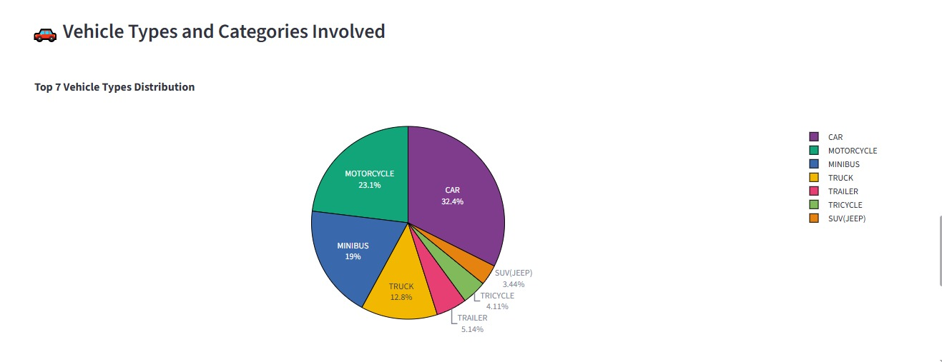
Why the Topic Matters
Road crashes lead to loss of lives, long-term disabilities, and emotional trauma.
They impose significant economic and healthcare burdens on society.
Understanding crash patterns enables evidence-based road safety policies and interventions

Slide 4
Description
Data Description
Tools & Methods
Python used for data cleaning, analysis, and visualization
Pandas and NumPy for data processing and aggregation
Matplotlib and Plotly for charts and trends
GeoPandas for spatial and hotspot analysis
Streamlit used to develop an interactive dashboard
Secondary data from Federal Road Safety Corps (FRSC) and National Bureau of Statistics (NBS)
Quarterly crash and casualty statistics (2021–2023)
Data on crash causes, vehicle categories, injuries, and deaths
Geospatial boundary data used to identify crash hotspots

Slide 5
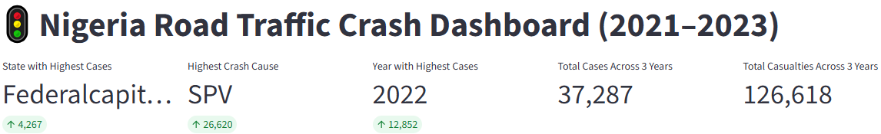
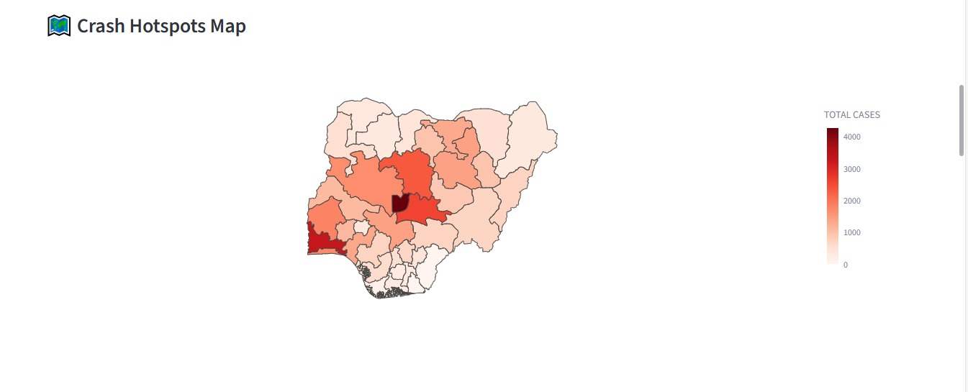
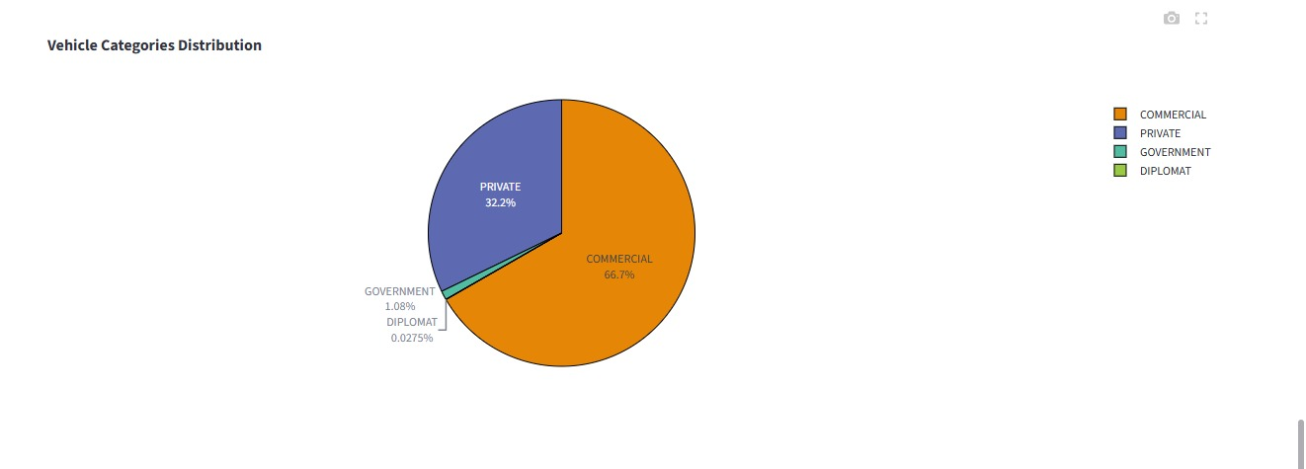
Key Findings
Certain states consistently recorded the highest crash volumes
Crash occurrence varied across quarters and years
Human-related factors were the leading causes of crashes
Commercial and private vehicles were most frequently involved
Males experienced higher injury and fatality rates

Slide 6
Supports targeted enforcement in high-risk states
Societal Impact
Informs public awareness and driver behaviour campaigns
Contributes to reduced healthcare burden and safer communities
Guides infrastructure planning and road safety investments

Slide 7
Conclusion
The project strengthened practical data analysis and visualization skills
It demonstrated the value of data-driven decision-making
Road crash statistics represent real human and economic costs
The findings provide a strong foundation for future research and policy action

Slide 8
Team
Gbena Edem Komla (Group Leader)
Nana Efua Bo Alan-Mensah
Emmanuel Mensah Quaye
Data integration, profiling and cleaning, Exploratory and descriptive analytics, Spatial visualization
Dashboard Deployment and Final Report and Presentation
Assisted with Spatial visualization
Eric Agbeko Kudah
Assisted with Data integration, profiling and cleaning

